Slide 1
Ethics in Social Work Research
Presented by: Irma Cruz, Jose Henry, Mary Miqui, Hena Zakir
SSW 751 – Social Work Research
Austin G. Oswald
10/13/2021

Slide 2
Ice Breaker
What is Ethics?
Why is Ethics a concern when conducting Social Work Research?
Notes:
Following several questionable research practices

Slide 3
Belmont Report
Start @ 0:30 secs
Principle 1 : Respect for Human Beings Principle 2 : Beneficence Principle 3 : Research Merit and Integrity Principle 4 : Justice
Notes:
Start at 0:30

Slide 4
Belmont Report
Principle 1 : Respect for Human Beings
Participants acting voluntarily and their rights are respected
Principle 2 : Beneficence
Research is done holistically and doesn’t solely benefit researcher
Research doesn’t put participants at risk
Principle 3: Justice
Research is inclusive & the burdens of research doesn’t outweigh the benefits
AU: Principle 4 : Research Merit and Integrity Principle
Researchers must be experienced and competent
Research should be well designed, and outcomes are clear to everyone involved
**Not a principle of U.S. Belmont Report but noteworthy**
Notes:
Determinations about justice require scrutiny of participant selection and enrollment processes.
Sample populations should be selected for reasons related to the problem being studied.
Particular classes (e.g., welfare patients, racial and ethnic minorities, or persons confined to institutions) are not targeted because of ease of access or manipulability, or for the convenience of the investigators.
Publicly funded research that leads to the development of therapeutic devices and procedures should
neither provide advantages to the more affluent in attaining these benefits
nor unduly involve persons from groups least likely to benefit from the developments.

Slide 5
5.2 Specific ethical issues to consider
What is Informed Consent?
The basic elements of the consent process includes:
A person voluntarily agrees to participate in a research study
Participant is informed of all aspects of the study
Individual has full understanding of what their participation entails
The risks and benefits to participating in research study are clear
Individual can withdraw at any time
Image by Pixabay, shared under the Pixabay license.

Slide 6
Protecting Identity
Anonymity
Research participant does not provide identifying information
Ex: Surveys , where you do not ask participants for their names.
Confidentiality
Research participants identity is known only by the researcher and protected from public exposure.
Ex: Maintain session notes in a drawer or on a desk away from visitors to the agency.

Slide 7
5.3 Ethics at micro, meso and macro levels
As social workers, we are constantly looking at the bigger picture while working with smaller details
Micro (individual): consider your own conduct and the rights of research participants
Knowing your identity and purpose of research
What rights do participants have in your research?
Meso (group) : consider the expectations of the profession, any organizations that may have funded the research, and the communities affected by the research
Be aware to not fall into confirmation bias or perpetuate negative stereotypes
Results should identify important areas for social workers to intervene NOT damage communities/groups - how do the results impact the target population(s)?
Macro (society): consider the duty to and the expectations of society with respect to social scientific research
How will this research live on?

Slide 8
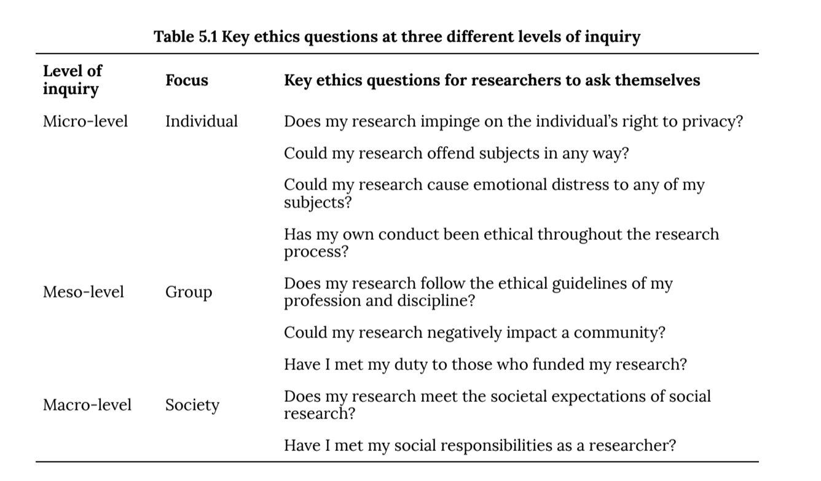
Questions to Ask Yourself

Slide 9
5.4 The Practice of science vs. The uses of science
Research ethics: Involves how research is conducted and how the data collected is used.
Personal and institutional ethical principles
Social workers must be transparent during their research procedures as well as their findings.
Honesty is important from the beginning of the process until then end
Identifying/recruiting
Collecting/ analyzing data
Gathering results
Social policies are established when researchers fully disclose how they conducted research.
Legitimize research findings
Honest about weaknesses and strengths in the study
Research should be able to be replicated

Slide 10
The purpose of this cartoon is that one can be bias when selecting which file drawer to open.
One can choose to pick whichever facts one likes best.
However, this method should not be practiced when conducting research. We should not be selective but instead be present and honest throughout the process.

Slide 11
Discussion
Two social work students decide to carry out their class research project by observing the nocturnal activities at a shelter for the homeless. The shelter has a limited number of beds and cannot accommodate everyone seeking housing. The two students show up and wait in line early enough to get beds and then watch and record the goings on at night while they pretend to be asleep.
A community organizer decides to observe and interview people and write about a demonstration against police brutality that is expected to be a lawful. The demonstration unexpectedly becomes violent, and property is destroyed. Law enforcement officials show up and demand that the organizer identify people observed breaking the law. Rather than risk arrest as an accomplice after the fact, the organizer complies.
Are the researchers performing ethically?
Explain.

Slide 12
Closing
Why is it difficult to enforce ethics in research?
Should the rules for Human Research be more specific?
Think about the potential loopholes that exist within the Belmont Report
How can we ensure our study respects the rights of participants?

